Slide 1

CONCEPTS OF PROGRAMMING LANGUAGES
12th Edition
Chapter 6
Data Types

Slide 2
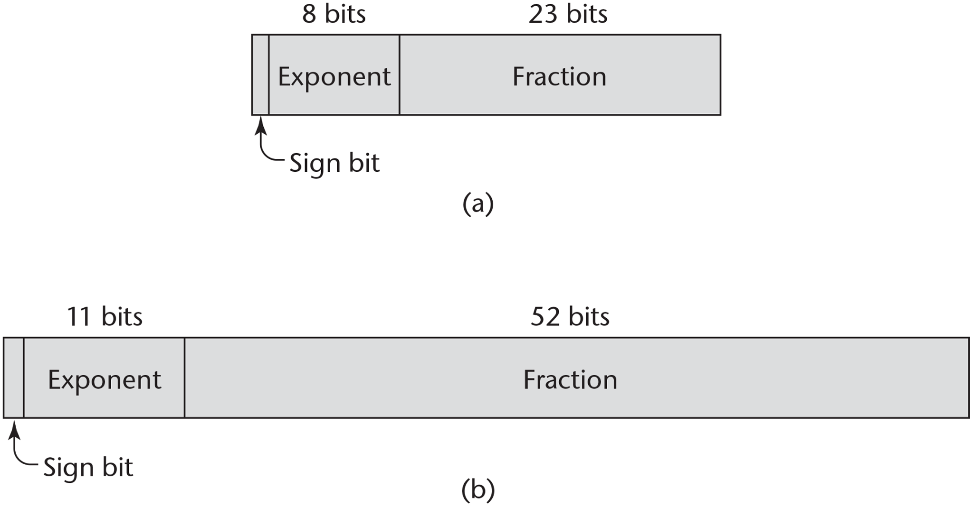
Figure 6-1 IEEE floating-point formats: (a) single precision, (b) double precision

Slide 3
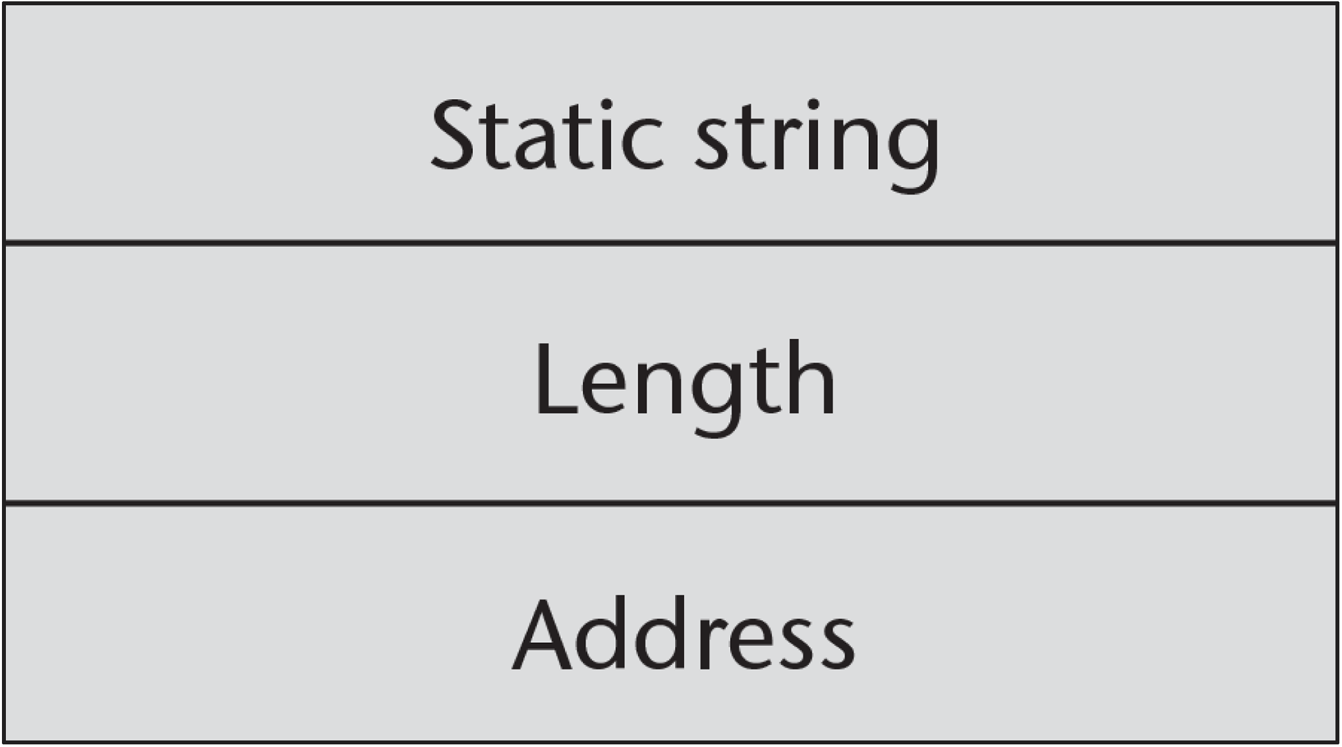
Figure 6-2 Compile-time descriptor for static strings

Slide 4
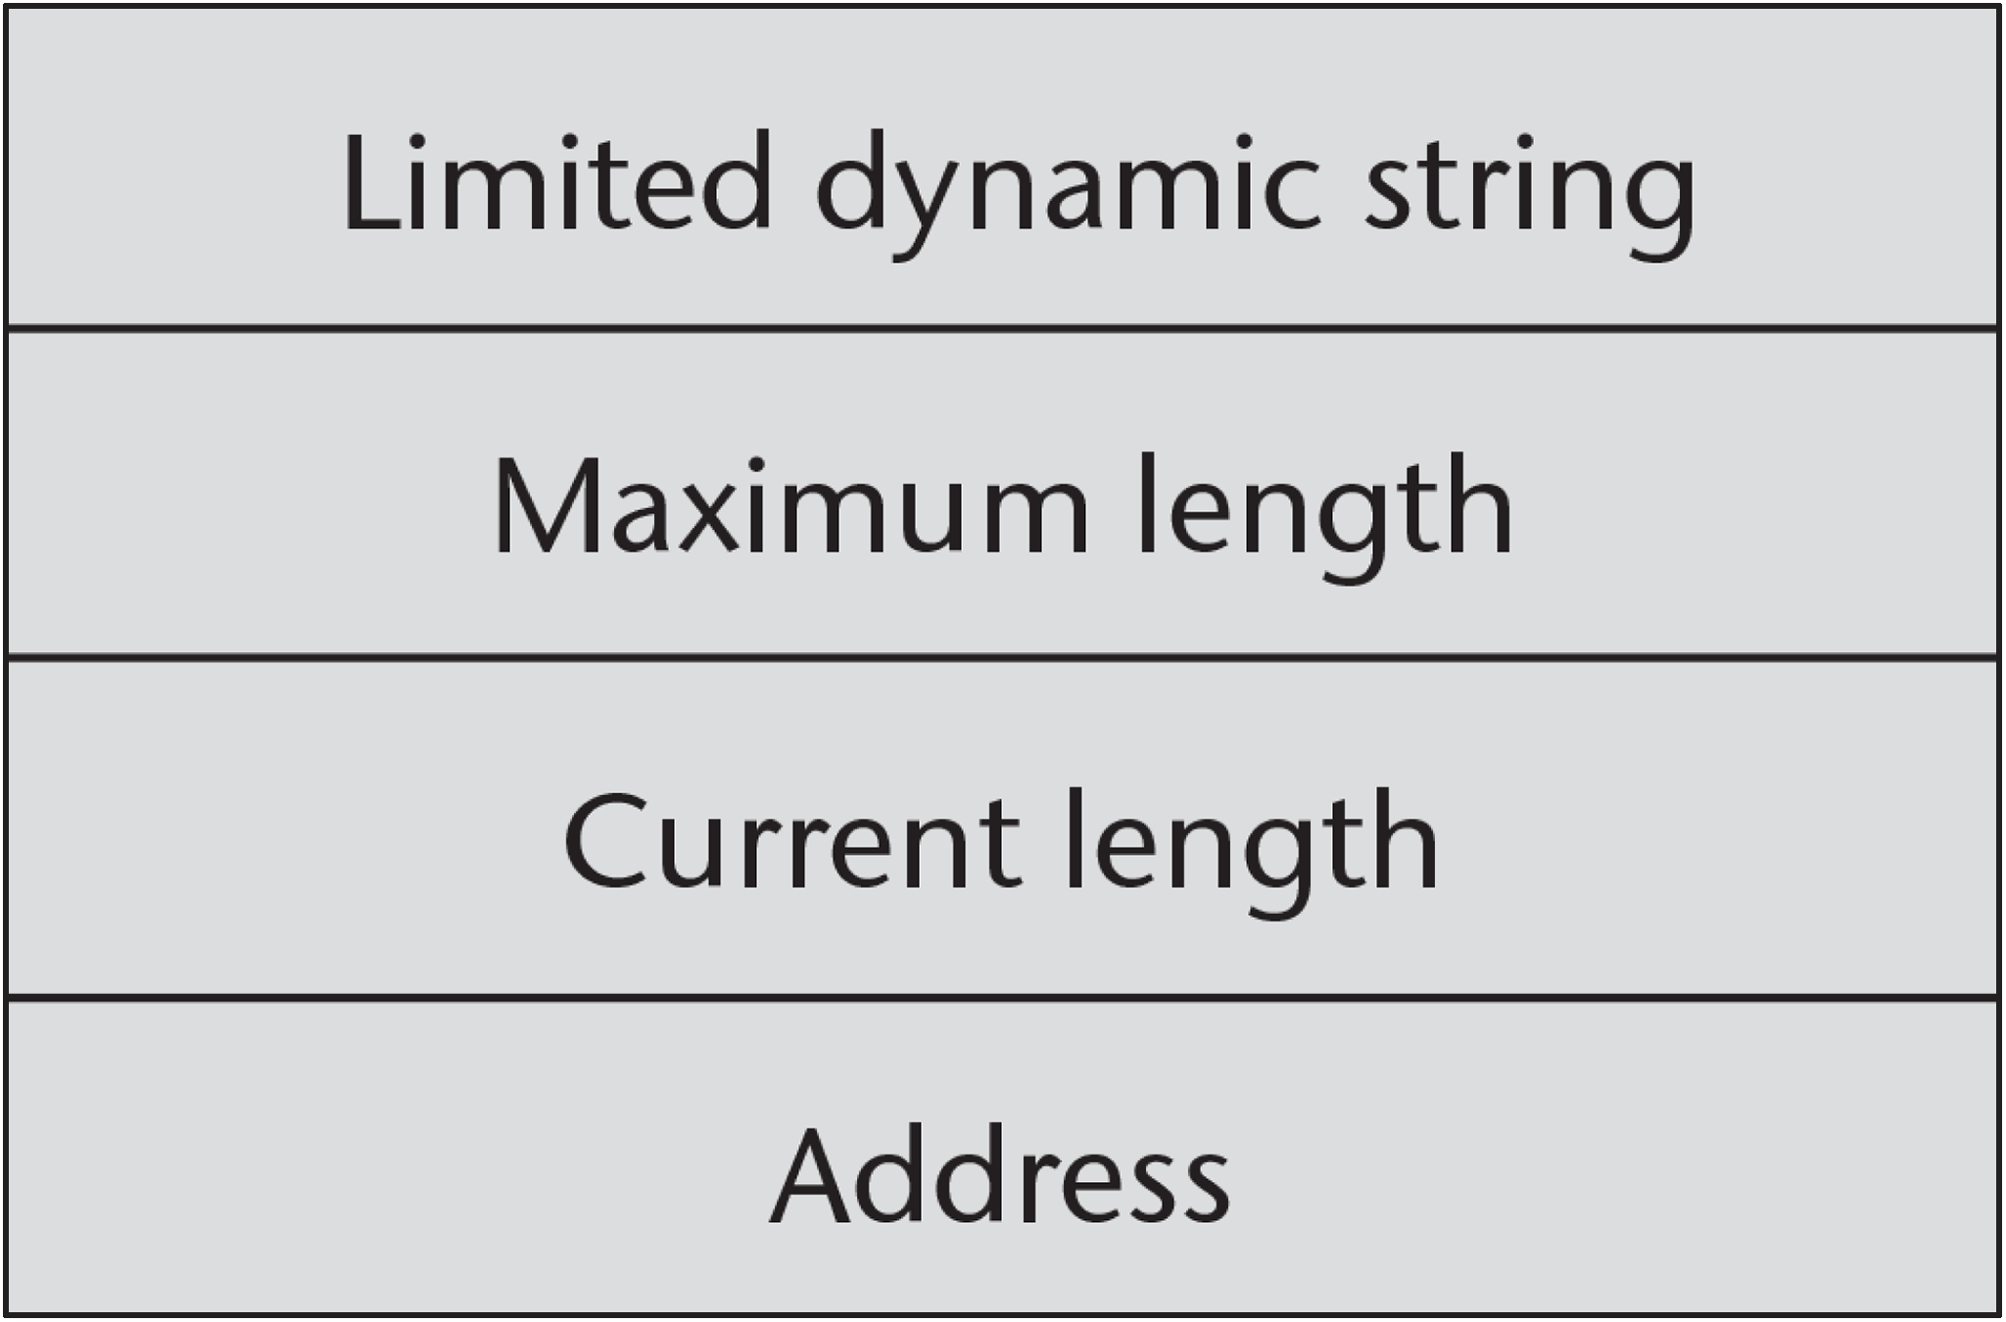
Figure 6-3 Run-time descriptor for limited dynamic strings

Slide 5
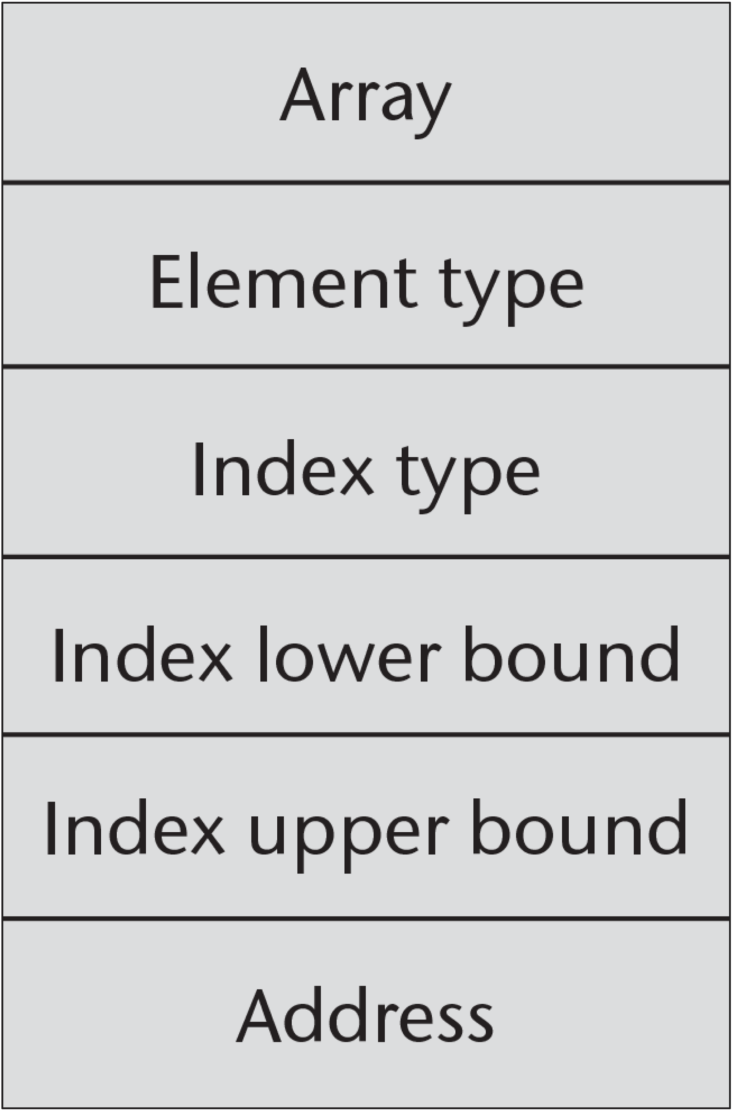
Figure 6-4 Compile-time descriptor for single-dimensioned arrays

Slide 6
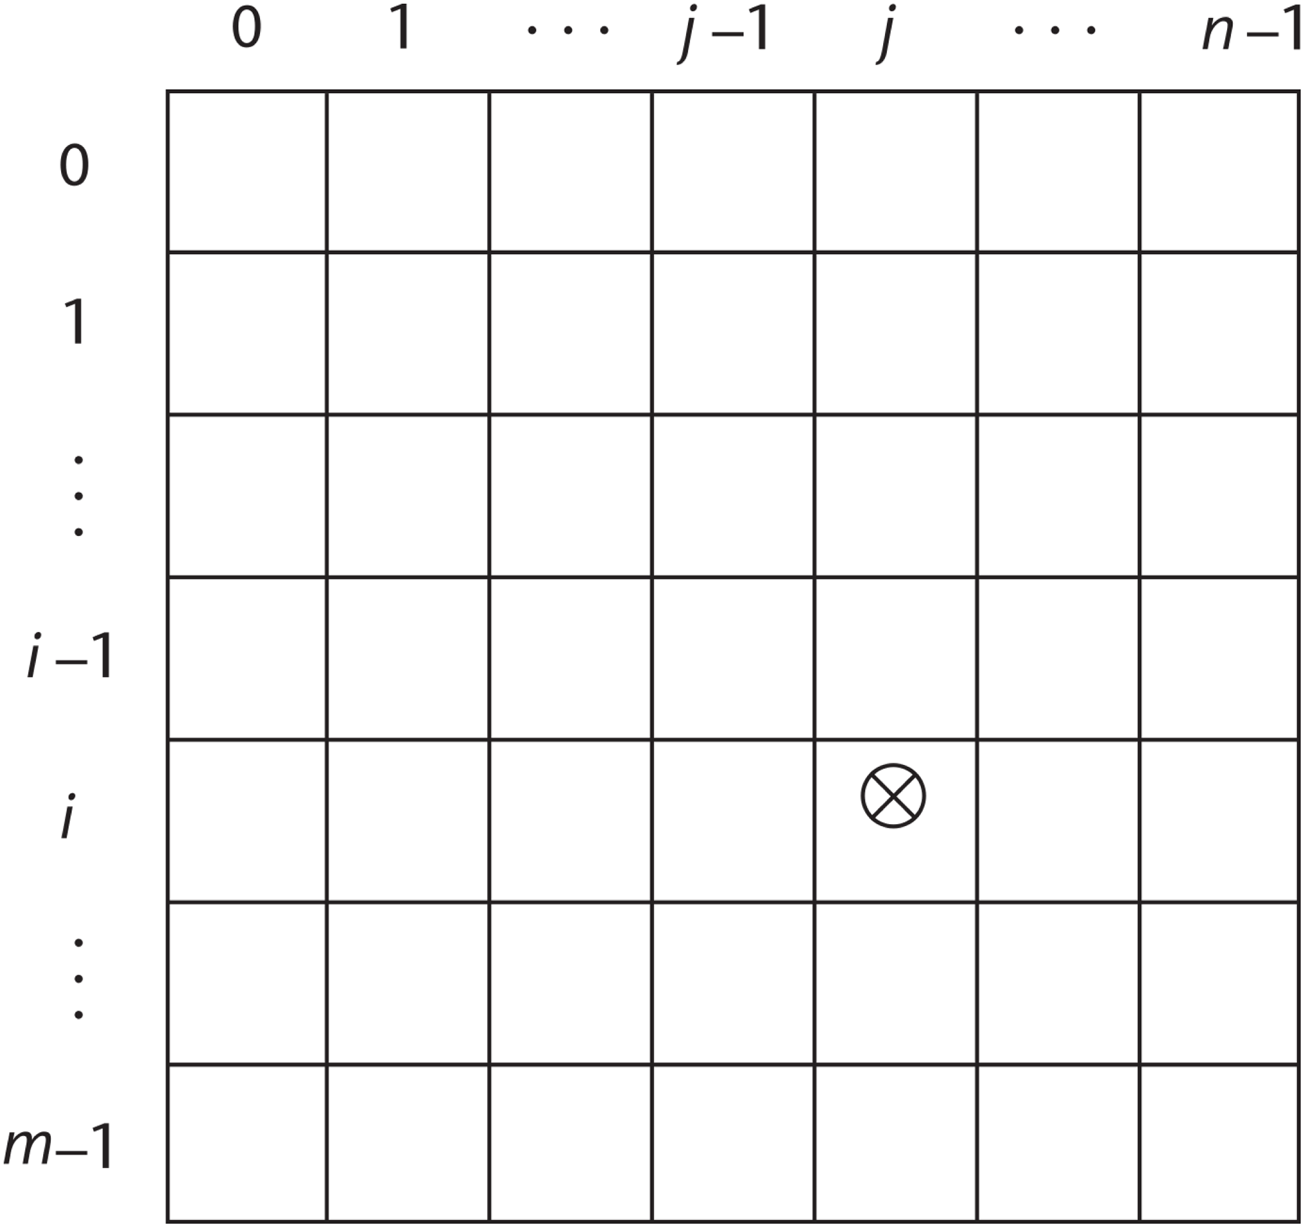
Figure 6-5 The location of the [i, j] element in a matrix

Slide 7
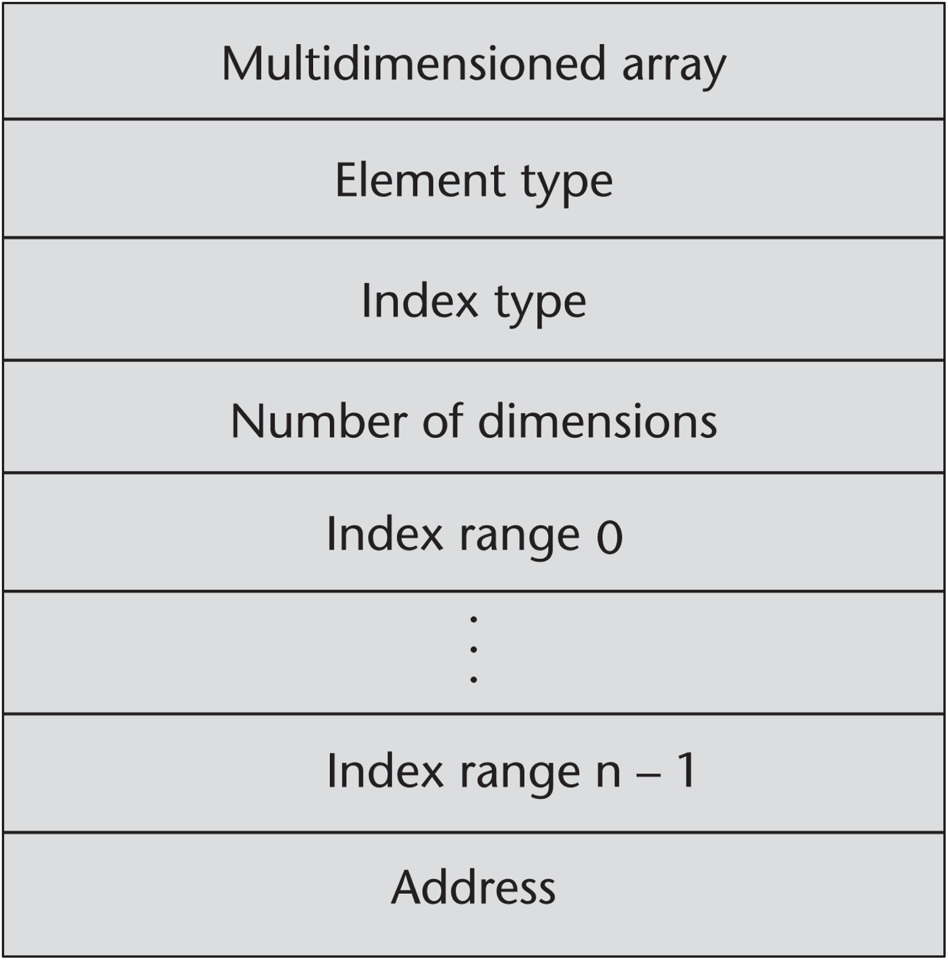
Figure 6-6 A compile-time descriptor for a multidimensional array

Slide 8
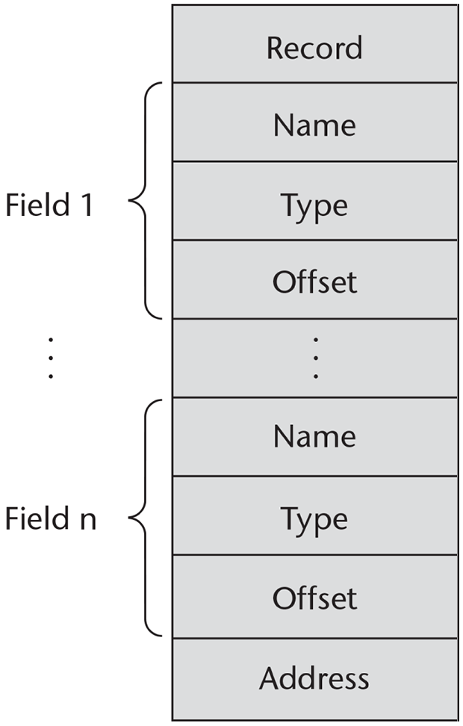
Figure 6-7 A compile-time descriptor for a record

Slide 9
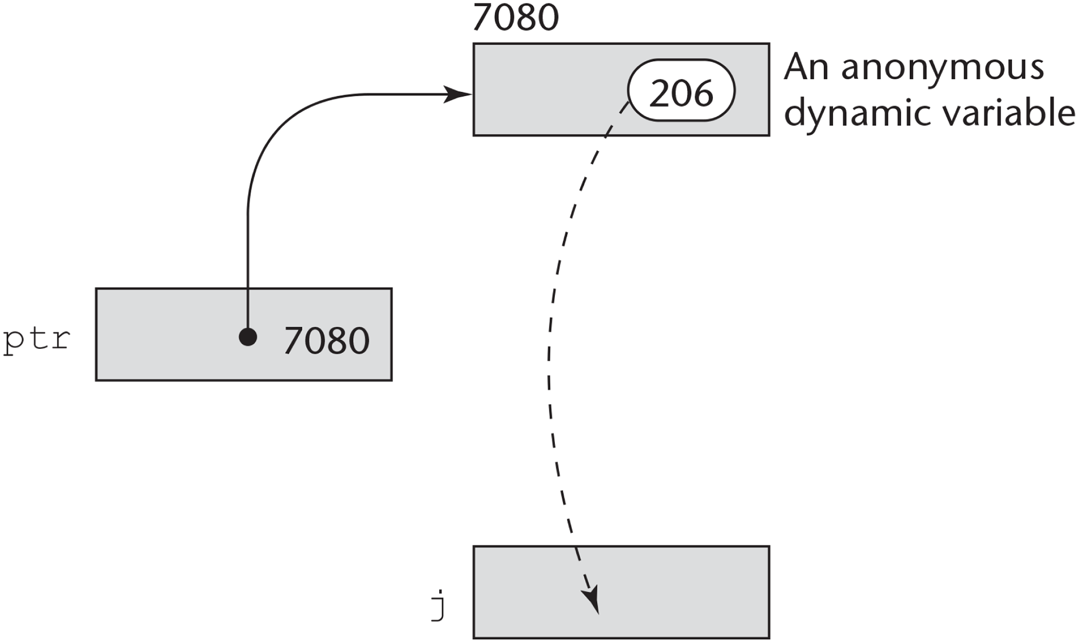
Figure 6-8 The assignment operation j = *ptr

Slide 10
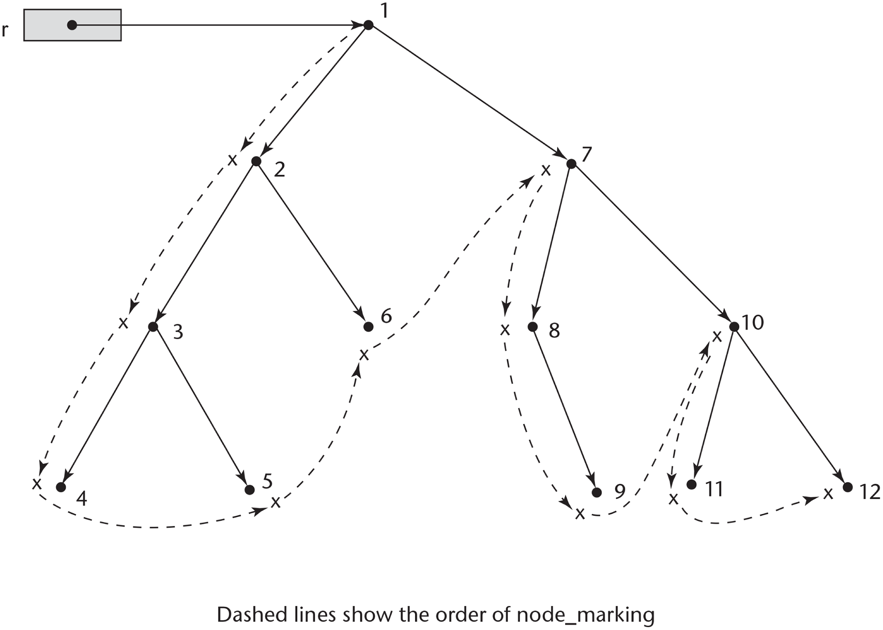
Figure 6-9 An example of the actions of the marking algorithm

